Slide 1


Notes:
What’s your name?

Slide 2

Notes:
I’m Màiri.

Slide 3
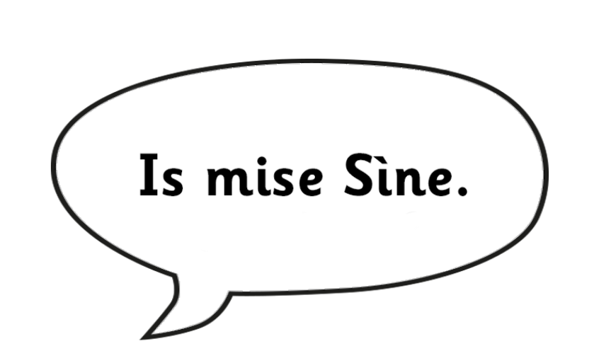
Notes:
I’m Sheena.

Slide 4
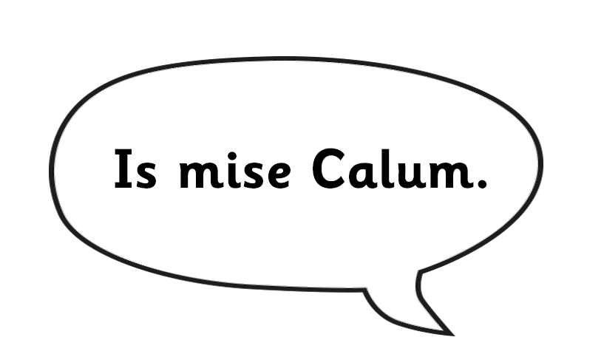
Notes:
I’m Calum.

Slide 5
Is mise Calum
Is mise Iain.
Notes:
I’m Iain.

Slide 6
Notes:
What’s your name?

Slide 7
Is mise Calum
Is mise…
Notes:
I’m …

